Slide 1



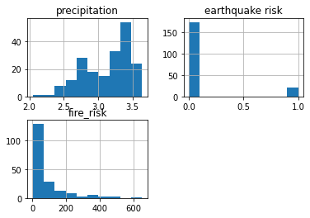
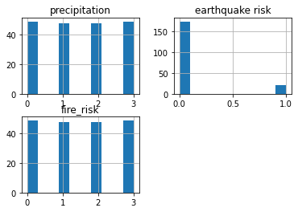
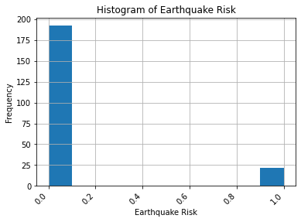
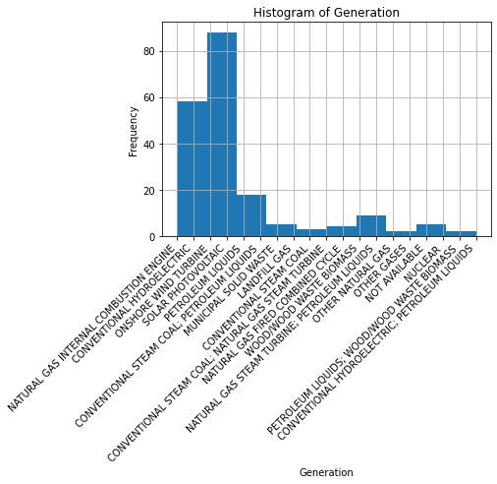
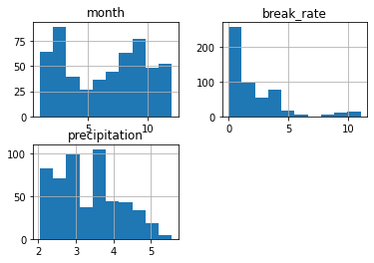
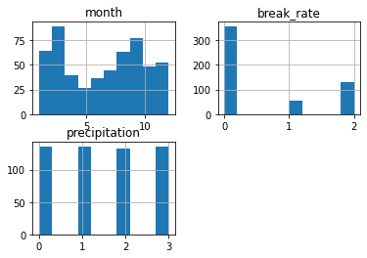
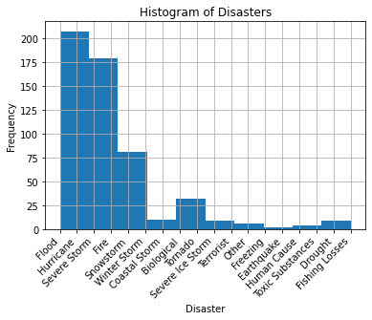
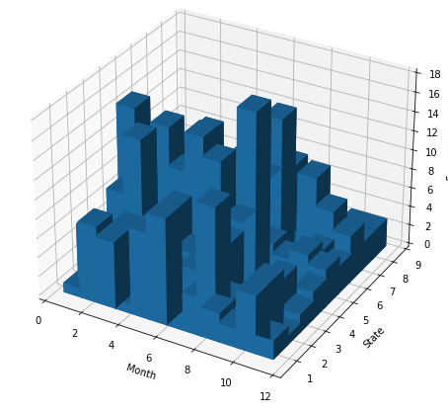
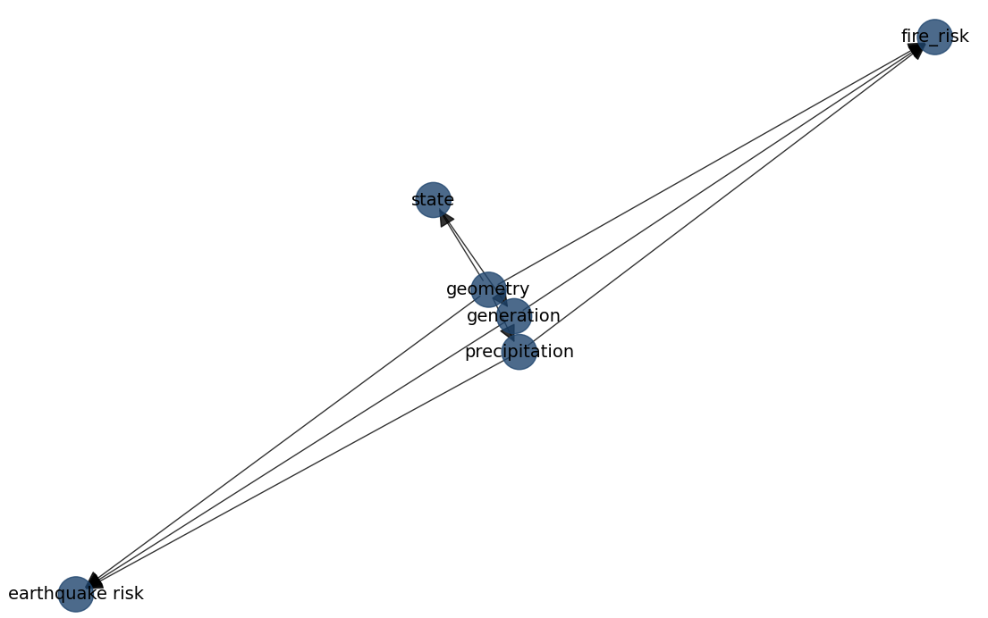
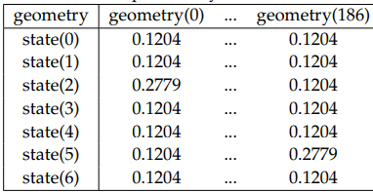
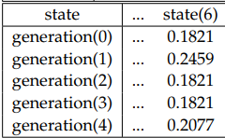
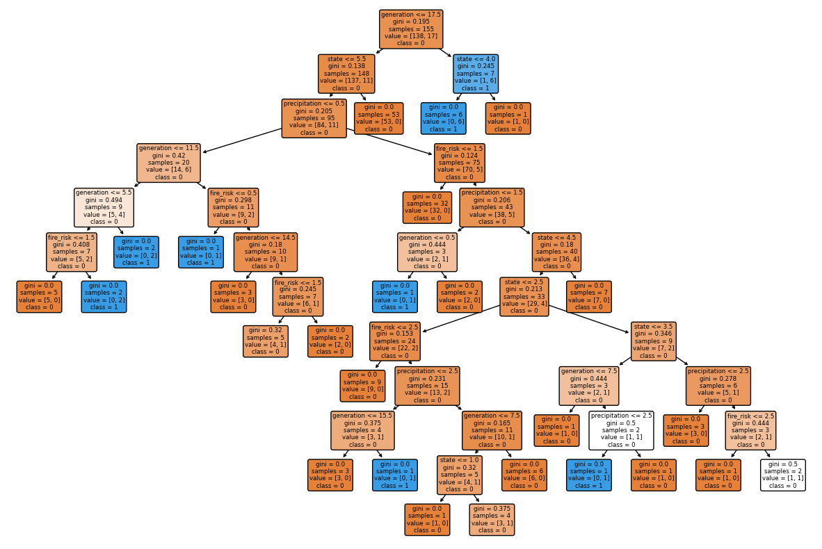
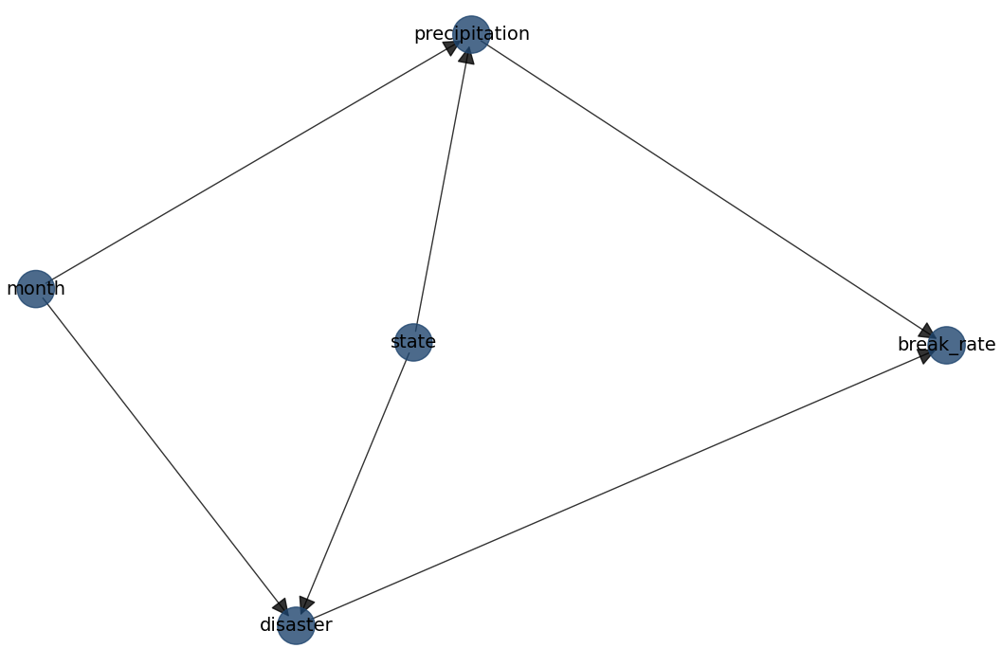
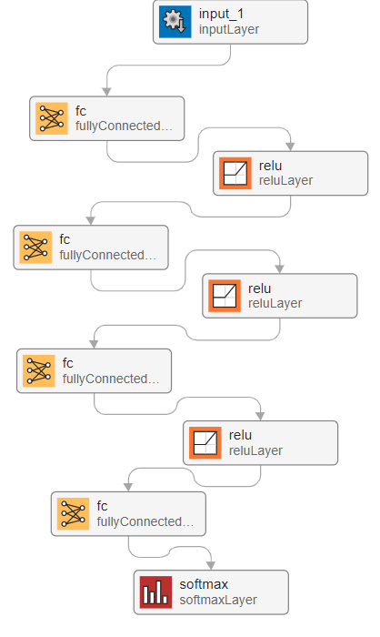
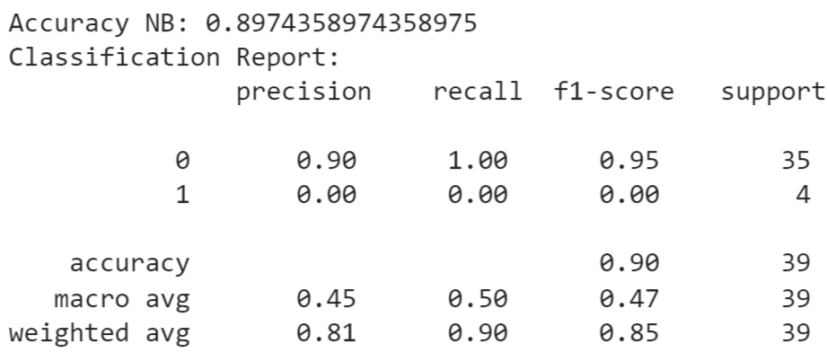
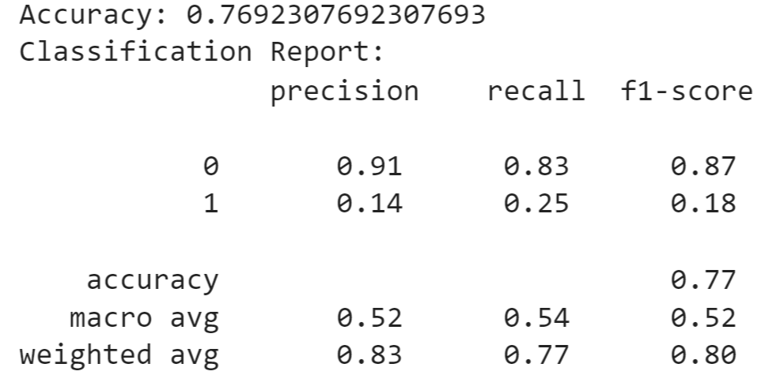
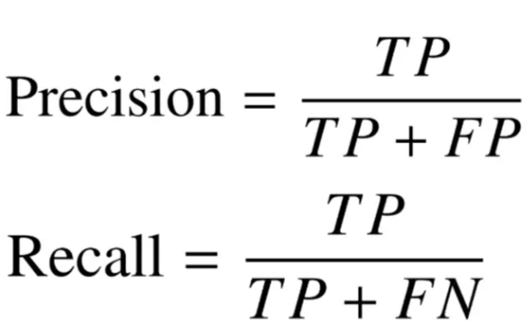
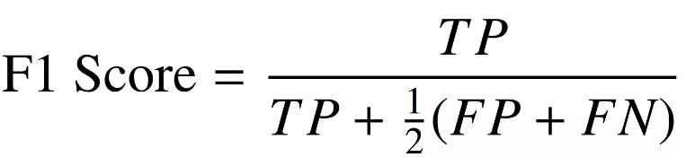
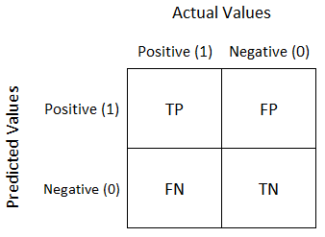
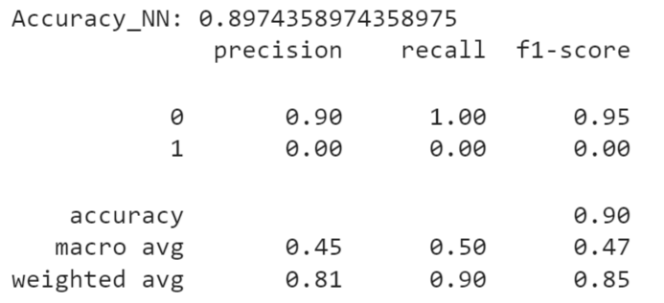
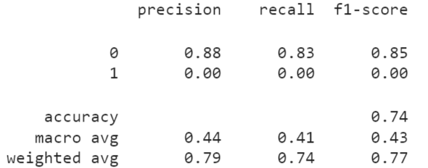
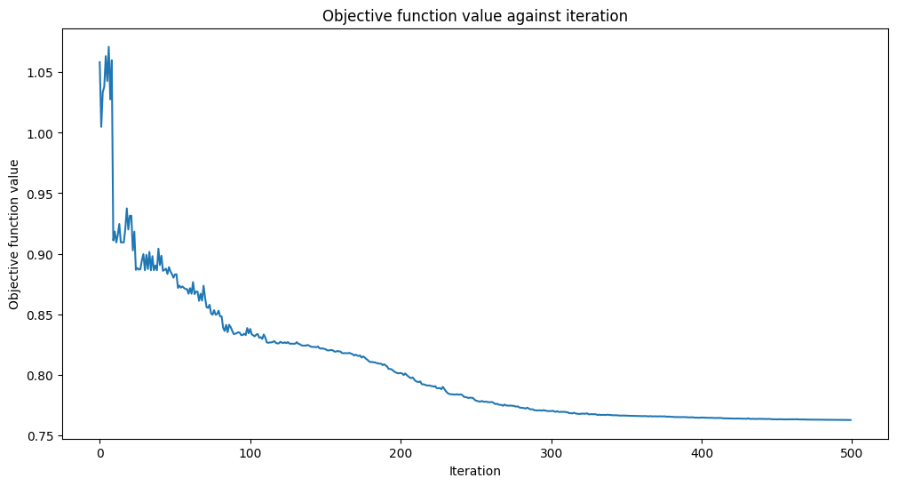
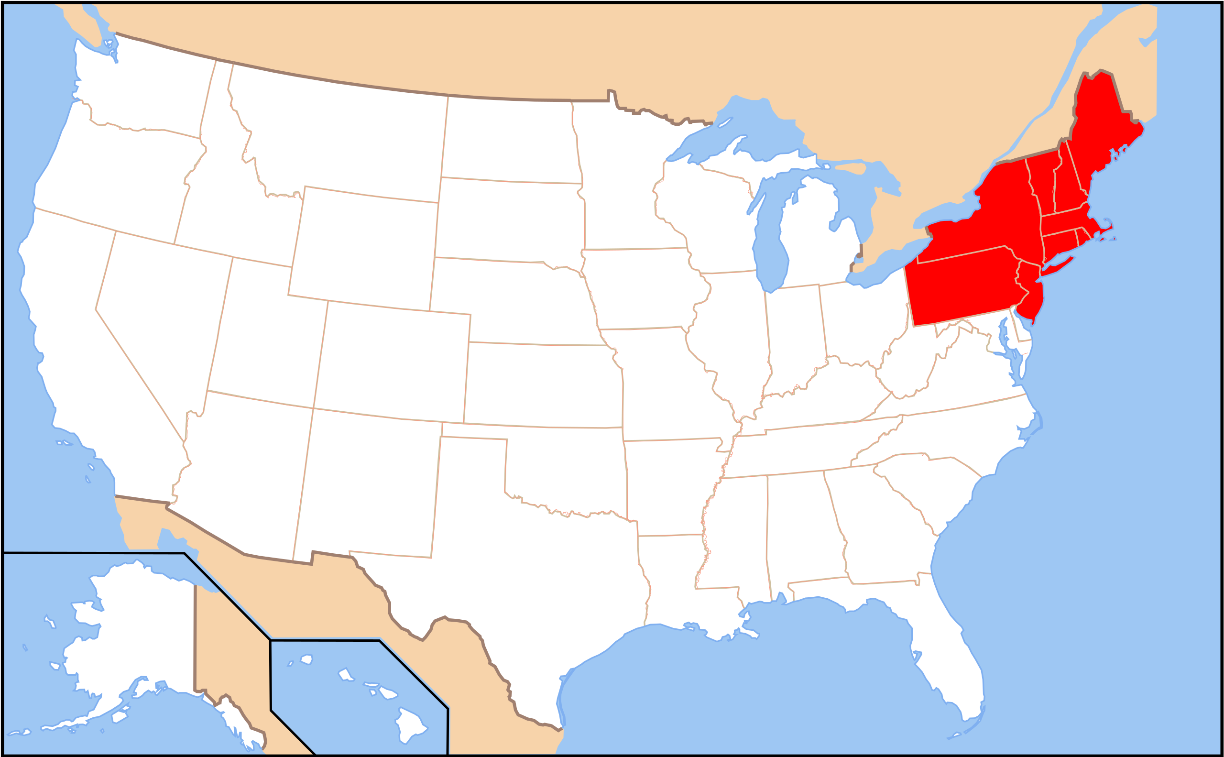
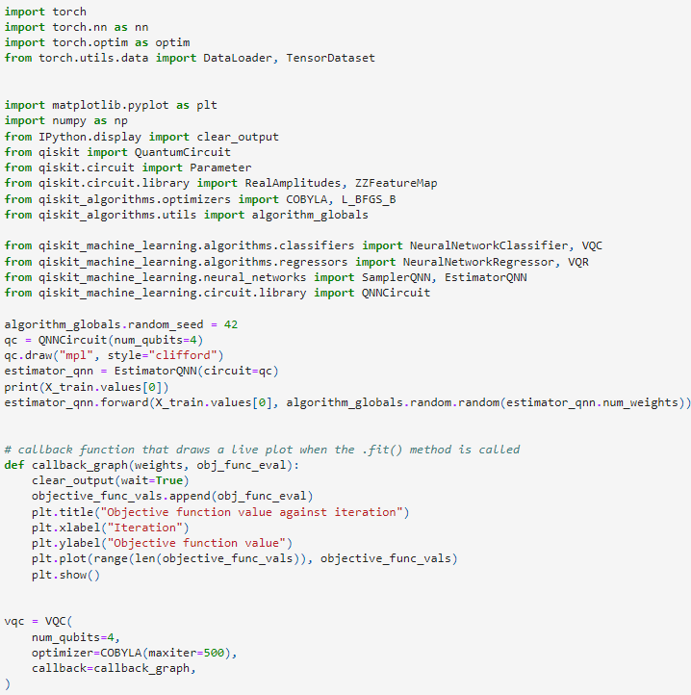
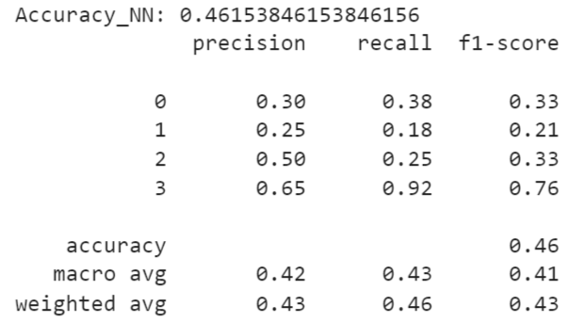
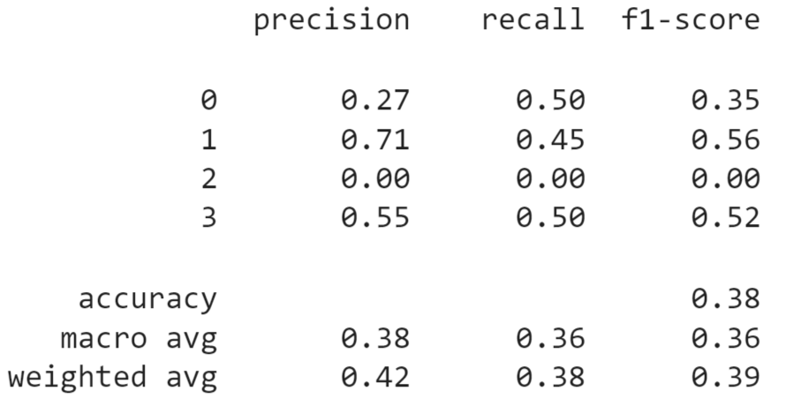
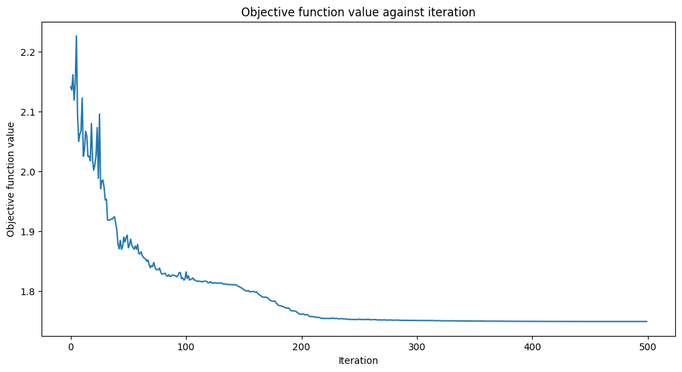
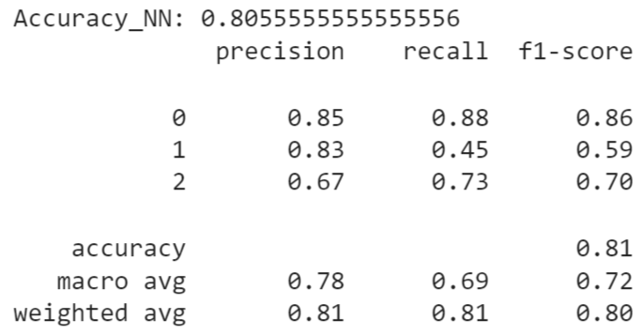
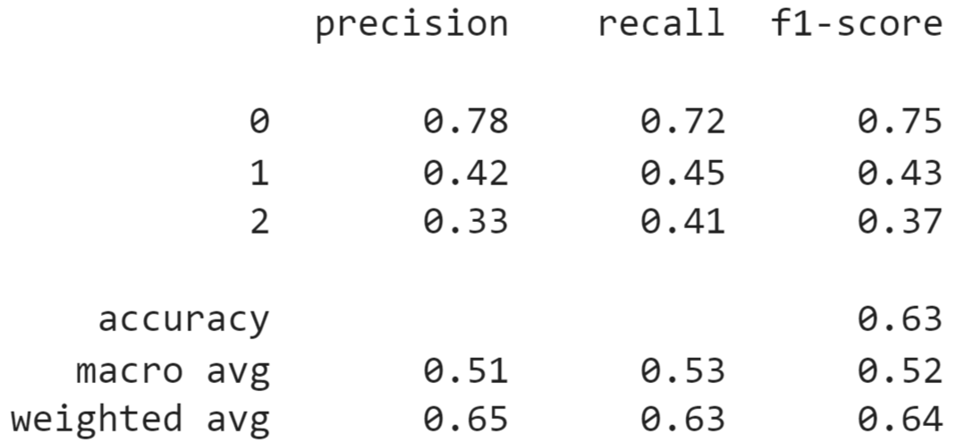
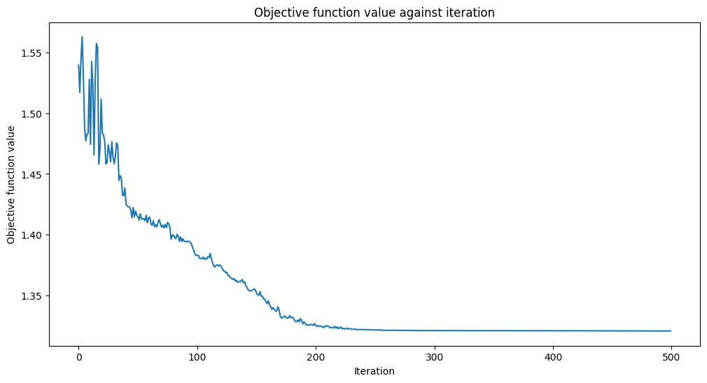
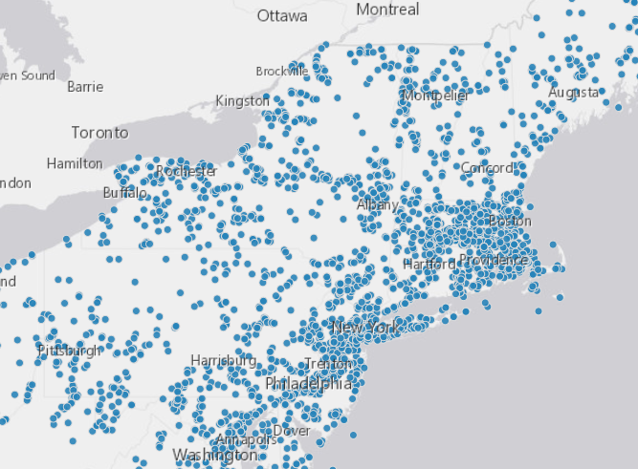
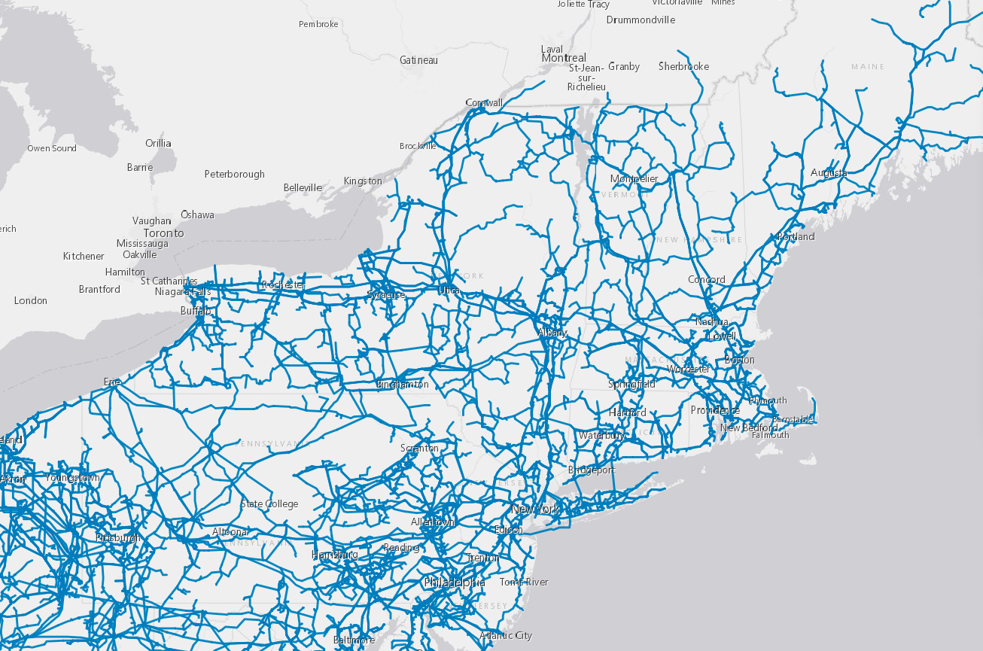
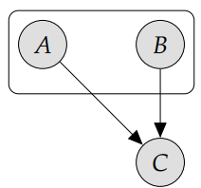

Comparison of Quantum & Classical Deep Learning
for Critical Infrastructure Risk Modeling
Neelanga Thelasingha (ECSE) , Thilanka Munasingha (ITWS)
(thelan@rpi.edu, munast@rpi.edu )
Rensselaer Polytechnic Institute, Troy, NY, United States
Introduction
Data Analysis
Energy infrastructure consists of a complex network of components; any failure would have critical consequences for society. To properly assess & mitigate risks to energy infrastructure, it is essential to consider potential hazards. Severe weather events, such as hurricanes, tornadoes, snowstorms, earthquakes, floods, wildfires, volcanic eruptions, & landslides, pose substantial threats. Additionally, non-natural hazards, including cyberattacks, physical attacks (such as terrorism), technical failures, human errors, and supply chain disruptions, further compound the challenges faced by the energy sector.
Understanding the interdependencies and interactions among these hazards is essential, as they often exhibit self-excitation & mutual excitation. For instance, earthquakes increase the likelihood of aftershocks, and rainstorms elevate the probability of floods or landslides. Recognizing and modeling these dynamic relationships is critical for risk assessment.
Bayesian networks are a powerful tool for modeling the vulnerability of energy infrastructure to various hazards and their subsequent influence on failures. Prior research has leveraged Bayesian networks as vulnerability models. This project builds upon this foundation, proposing a Bayesian network model that captures the influence flow of hazards through the vulnerability, subsequently triggering additional hazards.
Further, vulnerability is defined as the conditional probability of a failure occurring given the presence of a hazard. By comprehensively modeling these vulnerabilities, we gain valuable insights into how the influence of hazards propagates through the infrastructure, potentially setting off a cascade of failures. In this work, we describe the methodology employed, present the results of our risk models, and compare results using classical and quantum neural networks.
Dataset 1: to encode geographical features to enable vulnerability prediction
Continuous Variable Distribution Before Quantization
Continuous Variable Distribution After Quantization
Dataset 2: to encode time-dependent seasonality into features to enable hazards predictions
Continuous Variable Distribution Before Quantization
Continuous Variable Distribution After Quantization
Disaster declaration distribution across month and state
Model Development & Results
Dataset 1:
Learn conditional probability distribution – BN
Classify fire risk – DNN, QNN
Classify earthquake risk – DNN, QNN
Classify fire risk – NB
Classify earthquake risk – NB
Classify fire risk – DT
Classify earthquake risk – DT Dataset 2:
Learn conditional probability distribution – BN
Classify breakdown rate – DNN, QNN
Classify breakdown rate – NB
Classify breakdown rate – DT
fire risk – NB
fire risk – DT
Preliminaries
Classical DNN
Quantum NN
Geographical Region
Classical DNN Structure
fire risk
Construct the risk model by modeling the hazards and vulnerabilities present in the energy infrastructure
Region: NY, NJ, PA, CT, MA, ME, VT, NH, RI
presents a mixture of energy resources and diverse set of regions of socio-economical scale from metropolitan areas to rural regions
vulnerable to severe weather through snowstorms and rainstorms, while a minor earthquake risk is also present.
availability of verified publicly data
earthquake risk
Variational Quantum Classifier
breakdown rate
Data Sets
Energy Infrastructure Data: Homeland Infrastructure Foundation-Level Data
Precipitation Data: NASA POWER DATA
Earthquake Data: U.S Geological Survey: Earthquake Hazard Program
Disaster Declarations Data: FEMA Web Disaster Declarations
Conclusions
We explore the impact of hazards affecting critical infrastructure through seasonal severe weather and other events. Further, the vulnerability presented by geo-locations was analyzed as well.
The analysis of Dataset 1 yields the conditional probability distributions of
earthquake and fire risk through the Bayesian network. Thus, it can be used as an inference method to evaluate the vulnerability of a geo-location to the energy infrastructure.
Further, the analysis on Dataset 2 gives the ability to infer break down rate conditional on the month of the year, precipitation and disaster classifications through the Bayesian network. This provides useful insights into hazard occurrences and vulnerabilities present in the temporal dimension.
Power Disturbances: ISER Electric Disturbance Events
Fire Occurrence: National Interagency Fire Center
Models
Deep Neural Network (DNN)
Quantum Neural Network (QNN)
Bayesian Network (BN)
Naïve Bayes (NB)
Decision Tree (DT)
The classification models developed for both data sets present insights into dependencies present in the variables and their predictability. While DNN provided acceptable accuracies, the decision tree model performed well with explainable properties. We believe this work can be further improved by incorporating the data on transmission lines in the region as well as shown in figure. Further, increasing the spatial and temporal resolution will also contribute to higher accuracy.
Glossary:
NY – New York
NJ – New Jersey
PA – Philadelphia
CT – Connecticut
MA – Massachusetts
ME - Maryland
VT – Vermont
NH – New Hampshire
RI – Rhode Island
Resources:
Judea Pearl. “Bayesian networks”. In: (2011)
https://qiskit-community.github.io/qiskit-machine-learning/tutorials/02_neural_network_classifier_and_regressor.html
Python bnlearn: https://erdogant.github.io/bnlearn/pages/html/index.html
Python sklearn: https://scikit-learn.org/stable/
https : / / hifld - geoplatform . opendata . arcgis .com/datasets/geoplatform::power-plants-2/about.
https://power.larc.nasa.gov/, https://www.oe.netl.doe.gov/oe417.aspx
https://www.fema.gov/openfema-data-page/fema-web-disasterdeclarations-v1

